Slide 1


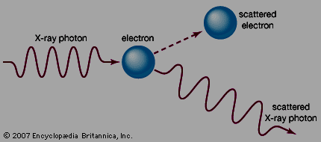
COMPTON
EFFECT
Notes:
What is RADAR an acronym for? Radio Detection and Ranging.
Radio wave is generated, transmitted, reflected, and detected.
RADAR unimpaired by night, fog, clouds, smoke.
Not as detailed as actual sight.
RADAR is good for isolated targets against a relatively featureless background.

Slide 2
SEQUENCE
DEFINITION OF COMPTON EFFECT
HISTORY OF COMPTON EFFECT
COMPTON EQUATION
SPECIAL CASES IN THE EQUATION
PAIR PRODUCTION

Slide 3
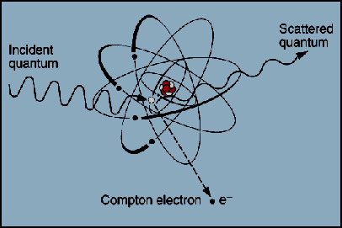
DEFINITON
► When an energetic photon strikes an electron (assumed to be initially at rest), it is scattered away from its original direction of motion while the electron receives an impulse and begins to move.
Notes:
What is RADAR an acronym for? Radio Detection and Ranging.
Radio wave is generated, transmitted, reflected, and detected.
RADAR unimpaired by night, fog, clouds, smoke.
Not as detailed as actual sight.
RADAR is good for isolated targets against a relatively featureless background.

Slide 4
DEFINITON
► In the collision, the photon may be regarded as having lost an amount of energy that is the same as the K.E gained by the electron. Consequently, the scattered photon has less energy than the incident photon.
Notes:
What is RADAR an acronym for? Radio Detection and Ranging.
Radio wave is generated, transmitted, reflected, and detected.
RADAR unimpaired by night, fog, clouds, smoke.
Not as detailed as actual sight.
RADAR is good for isolated targets against a relatively featureless background.

Slide 5
DEFINITON
► Therefore, the frequency of the scattered photon is shorter than that of incident photon. This alteration in frequency or wavelength of the photon due to the collision with electron is called COMPTON EFFECT after the name of its discoverer A.H. Compton.
Notes:
What is RADAR an acronym for? Radio Detection and Ranging.
Radio wave is generated, transmitted, reflected, and detected.
RADAR unimpaired by night, fog, clouds, smoke.
Not as detailed as actual sight.
RADAR is good for isolated targets against a relatively featureless background.

Slide 6
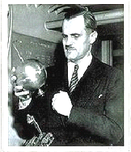
HISTORY IN BRIEF
♫ While at Washington University in St. Louis, Arthur H. Compton observed the scattering of x-rays from electrons in a carbon target and found scattered x-rays with a longer wavelength than those incident upon the target.
♫ Compton explained and modeled the data by assuming particle-wave duality of light on the basis of the quantum theory of light.
☻ Compton was awarded the Nobel Prize in 1927
Notes:
What is RADAR an acronym for? Radio Detection and Ranging.
Radio wave is generated, transmitted, reflected, and detected.
RADAR unimpaired by night, fog, clouds, smoke.
Not as detailed as actual sight.
RADAR is good for isolated targets against a relatively featureless background.

Slide 7
COMPTON EQUATION
10
11
12
13
8
9
E = hν′ p = hν′/c
Scattered Photon
(hν′/c) sin Φ
E = m₀c² p = 0
hν′/c
Incident Photon
)
)
(hν′/c) cos Φ
Φ
Φ
)
E = hν p = hν/c
Target electron
)
hν/c
θ
θ
p cos θ
p
Scattered electron
p sin θ
E = √ m₀ ²c⁴ + p²c² p = p
Notes:
What is RADAR an acronym for? Radio Detection and Ranging.
Radio wave is generated, transmitted, reflected, and detected.
RADAR unimpaired by night, fog, clouds, smoke.
Not as detailed as actual sight.
RADAR is good for isolated targets against a relatively featureless background.

Slide 8
COMPTON EQUATION
► Let an energetic (X-ray) photon of energy E=hν and momentum hν/c strikes a free electron at rest.
► The energy of incident photon will be divided into energy of scattered photon = hν’ and energy of electron = KE
For any particle E = √m₀ ²c⁴ + p²c² For photon, m₀= 0 So E = pc and E = hν p = hν/c
► For conservation of energy hν - h ν’ = KE ………(1)
Momentum of photon = hν/c
Notes:
What is RADAR an acronym for? Radio Detection and Ranging.
Radio wave is generated, transmitted, reflected, and detected.
RADAR unimpaired by night, fog, clouds, smoke.
Not as detailed as actual sight.
RADAR is good for isolated targets against a relatively featureless background.

Slide 9
COMPTON EQUATION
► For conservation of momentum
along original photon direction hν/c + 0 = (hν’/c ) cosΦ + p cosθ………(2)
And along perpendicular direction 0 + 0 = (hν’/c ) sinΦ + p sinθ ………(3)
► Multiplying eqn (2) & (3) by c, we have pc cosθ = hν - hν’cosΦ ………(4) and pc sinθ = hν’ sinΦ ………(5)
► Squaring eqn (4) & (5) and adding, we have p²c² = h²ν² – 2(hν)(hν’)cosΦ + (hν’)²………(6)
Notes:
What is RADAR an acronym for? Radio Detection and Ranging.
Radio wave is generated, transmitted, reflected, and detected.
RADAR unimpaired by night, fog, clouds, smoke.
Not as detailed as actual sight.
RADAR is good for isolated targets against a relatively featureless background.

Slide 10
COMPTON EQUATION
► We know the total energy E = KE + m₀c²
Again, for all particles E = √ m₀ ²c⁴ + p²c²
► Therefore, KE + m₀c² = √ m₀ ²c⁴ + p²c²
or m₀ ²c⁴ + p²c² = (KE)² + 2 m₀c² KE + m₀ ²c⁴
or p²c² = (KE)² + 2 m₀c² KE
or p²c² = (hν - h ν’ )² + 2 m₀c² (hν - h ν’) …(7)
From equation (6) & (7) , we have
Notes:
What is RADAR an acronym for? Radio Detection and Ranging.
Radio wave is generated, transmitted, reflected, and detected.
RADAR unimpaired by night, fog, clouds, smoke.
Not as detailed as actual sight.
RADAR is good for isolated targets against a relatively featureless background.

Slide 11
COMPTON EQUATION
(hν - h ν’ )² + 2 m₀c² (hν - h ν’) = h²ν² - 2(hν)(hν’)cosΦ + (hν’)²
or - 2(hν)(hν’) + 2 m₀c² (hν - h ν’) = 2(hν)(hν’)cosΦ or m₀c² (hν - h ν’) = (hν)(hν’) (1 - cosΦ ) ………(8)
Dividing this equation by h²c², we have
m₀c /h (ν/c - ν’/c) = (ν/c)(ν’/c) (1 - cosΦ )
or m₀c /h ( 1/λ - 1/λ’ ) = (1 - cosΦ )/ λλ’
Notes:
What is RADAR an acronym for? Radio Detection and Ranging.
Radio wave is generated, transmitted, reflected, and detected.
RADAR unimpaired by night, fog, clouds, smoke.
Not as detailed as actual sight.
RADAR is good for isolated targets against a relatively featureless background.

Slide 12
COMPTON EQUATION
or m₀c /h ( 1/λ - 1/λ’ ) = (1 - cosΦ )/ λλ’
λ’ – λ = h / m₀c (1 - cosΦ )
Therefore, the wavelength of the scattered photon is greater than the wavelength of the incident photon.
The quantity λ_{c} = h /m₀c is called Compton wavelength of the scattering particle.
λ’ – λ = λ_{c} (1 - cosΦ )
Notes:
What is RADAR an acronym for? Radio Detection and Ranging.
Radio wave is generated, transmitted, reflected, and detected.
RADAR unimpaired by night, fog, clouds, smoke.
Not as detailed as actual sight.
RADAR is good for isolated targets against a relatively featureless background.

Slide 13

COMPTON EQUATION
Special cases
1. When Φ = 0⁰ , cosΦ = 1
λ’ – λ = 0
2. When Φ = 90⁰ , cosΦ = 0
λ’ – λ = h / m₀c = 0.024
3. When Φ = 180⁰ , cosΦ = -1
λ’ – λ = 2h / m₀c = 0.048
Therefore, max wavelength change occurs when Φ = 180⁰ because the compton wavelength of an electron is 0.024
Notes:
What is RADAR an acronym for? Radio Detection and Ranging.
Radio wave is generated, transmitted, reflected, and detected.
RADAR unimpaired by night, fog, clouds, smoke.
Not as detailed as actual sight.
RADAR is good for isolated targets against a relatively featureless background.

Slide 14
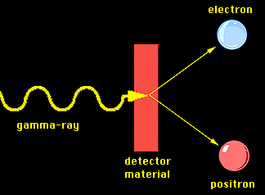
PAIR PRODUCTION
► In a collision, a photon can give an electron all of its energy (photoelectric effect) or only part (Compton effect)
► It is also possible for a photon to materialize into an electron and positron (positively charged electron)
Notes:
What is RADAR an acronym for? Radio Detection and Ranging.
Radio wave is generated, transmitted, reflected, and detected.
RADAR unimpaired by night, fog, clouds, smoke.
Not as detailed as actual sight.
RADAR is good for isolated targets against a relatively featureless background.

Slide 15
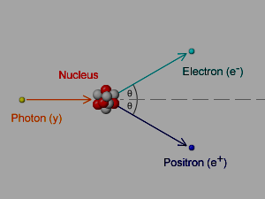
PAIR PRODUCTION
► Therefore, when a photon of energy hν is passed thorough a nucleus a pair of electron and positron is formed near to the atomic nuclei, is called pair production.
► Here, em energy is converted into matter.
Notes:
What is RADAR an acronym for? Radio Detection and Ranging.
Radio wave is generated, transmitted, reflected, and detected.
RADAR unimpaired by night, fog, clouds, smoke.
Not as detailed as actual sight.
RADAR is good for isolated targets against a relatively featureless background.

Slide 16


DE-BROGLIE WAVE
► De-Broglie proposed that material particles like photon possesses wave as well as particle properties. This wave is called de-Broglie wave.
A photon of light of frequency has the momentum
ν
Notes:
What is RADAR an acronym for? Radio Detection and Ranging.
Radio wave is generated, transmitted, reflected, and detected.
RADAR unimpaired by night, fog, clouds, smoke.
Not as detailed as actual sight.
RADAR is good for isolated targets against a relatively featureless background.

Slide 17

DE-BROGLIE WAVE
► The wavelength of a photon is therefore specified by the relation
This wavelength is called de-Broglie wavelength.
De-Broglie suggested that equation (1) is completely general one that applies to material particle as well as photons.
Notes:
What is RADAR an acronym for? Radio Detection and Ranging.
Radio wave is generated, transmitted, reflected, and detected.
RADAR unimpaired by night, fog, clouds, smoke.
Not as detailed as actual sight.
RADAR is good for isolated targets against a relatively featureless background.

Slide 18

DE-BROGLIE WAVE
►The momentum of a particle of mass m and velocity v is given by
and its de-Broglie wavelength is accordingly
Thus, the greater the particle’s momentum, the shorter its wavelength.
Notes:
What is RADAR an acronym for? Radio Detection and Ranging.
Radio wave is generated, transmitted, reflected, and detected.
RADAR unimpaired by night, fog, clouds, smoke.
Not as detailed as actual sight.
RADAR is good for isolated targets against a relatively featureless background.

Slide 19




DE-BROGLIE WAVE
We know,
Again, we know
This is the expression for the Broglie wavelength in terms of energy.
Notes:
What is RADAR an acronym for? Radio Detection and Ranging.
Radio wave is generated, transmitted, reflected, and detected.
RADAR unimpaired by night, fog, clouds, smoke.
Not as detailed as actual sight.
RADAR is good for isolated targets against a relatively featureless background.

Slide 20


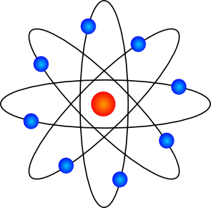
ATOMIC MODEL
Notes:
What is RADAR an acronym for? Radio Detection and Ranging.
Radio wave is generated, transmitted, reflected, and detected.
RADAR unimpaired by night, fog, clouds, smoke.
Not as detailed as actual sight.
RADAR is good for isolated targets against a relatively featureless background.

Slide 21

Atomic Models: Greek
Democritus (460-370 B.C.) → Matter can not be divided forever
Smallest piece = “atom”
(Gk “atomos” = “not to be cut”)
He had no way of knowing what atoms looked like!

Slide 22
The word “atom” comes from a Greek word that means “unable to be cut”
Imagine you had a piece of gold that you then cut in half…
…and then you cut one of these smaller pieces in half…
Gold
Go
ld

Slide 23
The word “atom” comes from a Greek word that means “unable to be cut”
Eventually you would have 1 piece of gold left. If you cut it in half, you wouldn’t have gold any more – you’d have something else. This tiny, tiny single piece of gold is called an atom of gold. An atom is the smallest particle of an element that acts like the element.
…and kept going…
…and kept going…
An atom of gold

Slide 24
Atomic Models : Dalton
Atomic Models: J Thomson
Atomic Models: Rutherford

Slide 25
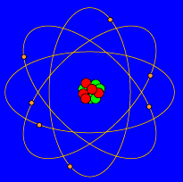
Atomic Models: Bohr
Electrons are found in specific energy levels
  Like planets around the sun

Slide 26
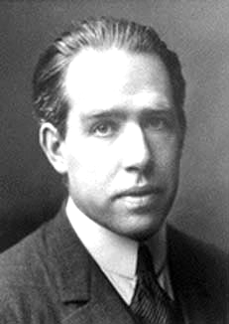
BOHR'S ATOM MODEL
Niels Henrik David Bohr. (1884-1962)
In 1913, Bohr suggested his atom model for which he was awarded Nobel Prize for Physics in 1922
Notes:
What is RADAR an acronym for? Radio Detection and Ranging.
Radio wave is generated, transmitted, reflected, and detected.
RADAR unimpaired by night, fog, clouds, smoke.
Not as detailed as actual sight.
RADAR is good for isolated targets against a relatively featureless background.

Slide 27


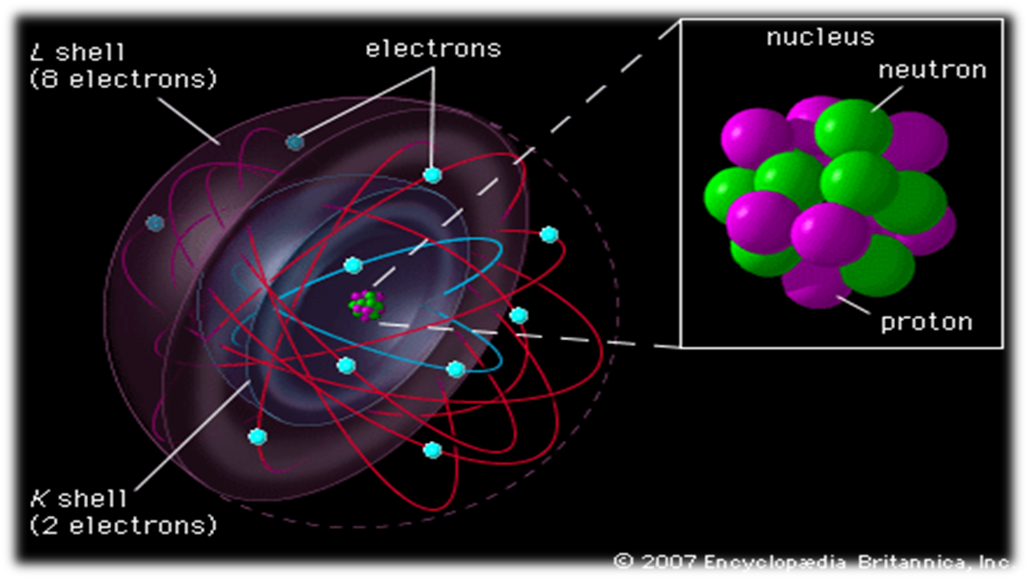
BOHR'S ATOM MODEL
1
Positively charged nucleus are at the centre and negatively charged electrons revolve round the nucleus in various circular orbit.

Slide 28

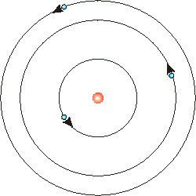
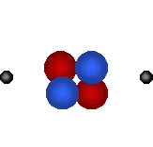
BOHR'S ATOM MODEL
Energy level
2
The electrons revolving round the nucleus only in certain permitted orbits are called energy levels. i.e. orbits of certain radii are allowed.

Slide 29
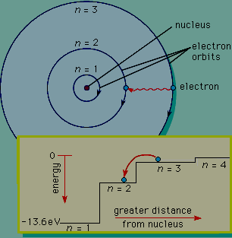

BOHR'S ATOM MODEL
3
Each energy level has a certain fixed amount of energy. The larger the orbit (i.e. larger radius), the greater is the energy of electrons.

Slide 30
BOHR'S ATOM MODEL
4
Electrons gives out energy in the form of electromagnetic radiation when it jumps from higher to lower level.

Slide 31
BOHR'S POSTULATES OF H
Electron
Nucleus
1
An atom consists of positively charged nucleus at the centre

Slide 32
BOHR'S POSTULATES OF H
2
Electron
The negatively charged electrons move round the nucleus in various orbits known as stationary energy levels.
Nucleus
The electrons can’t emit radiations when moving in their own stationary level

Slide 33
BOHR'S POSTULATES OF H
3
The Coulombian and Newtonian forces are applicable in the domain of the atom
Electron
Nucleus
Coulomb force
4
The angular momentum for electron mvr = nh/2π

Slide 34
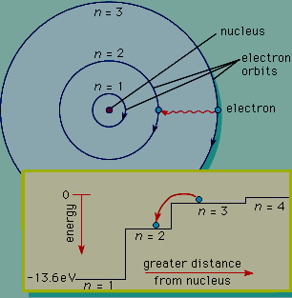
BOHR'S POSTULATES OF H
W_{n3}
5
When an electron jumps from a higher energy level to a lower energy level, it gives out EM radiations of a particular frequency
W_{n2}
hv
W_{n1}
W_{n2} – W_{n1} = hv

Slide 35

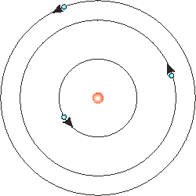

CALCULATION OF RADIUS
Let us consider an atom having
Nucleus of charge E = Ze
Electron of charge = e
Radius of an orbit = r
The electrostatic force of attraction
F_{e} = Ee / 4πε₀ r² ….. (1)
The centripetal force
F_{c} = mv²/ r …………(2)
n₃
n₂
Electron
n₁
e
Nucleus
r
E
The condition for dynamically stable orbit is F_{e} = F_{c}

Slide 36
CALCULATION OF RADIUS
mv²/ r = Ze² / 4πε₀ r²
mv² = Ze² / 4πε₀r ………(3)
We know, the angular momentum,
mvr = nh / 2π
or, v = nh / 2πmr ……(4)
Eqn (3) becomes
m( nh/2πmr)² = Ze² / 4πε₀r
r = ε₀n²h² / πmZe² ….(5)
n₃
n₂
Electron
n₁
e
Nucleus
r
E
This is the eqn for radius →

Slide 37
CALCULATION OF RADIUS
From eqn (5) r ∞ n²
So the radii are in the ratio of 1 : 4 : 9 : 16 etc . From equation (5) the radius of the first orbit of hydrogen r = 5.29 x 10⁻¹¹m, where n =1 and Z = 1
Substituting r in eqn (4)
v = Ze² / 2ε₀nh
n₃
n₂
Electron
n₁
e
Nucleus
r
E
This equation shows that v is inversely proportional to n

Slide 38
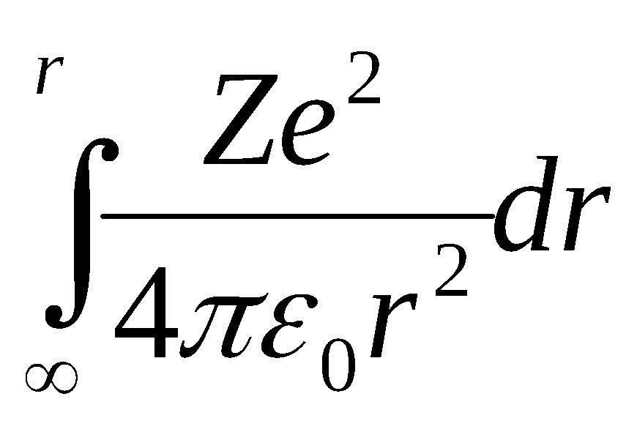
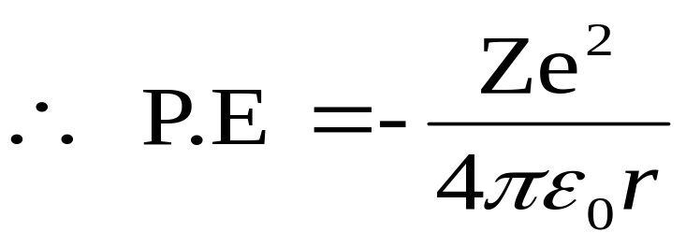
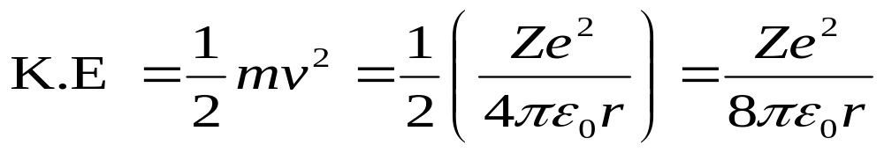
CALCULATION OF ENERGY
The energy is partly potential and partly kinetic.
The potential energy of electron =
n₃
n₂
n₁
Electron
e
Nucleus
r
E
And kinetic energy of electron

Slide 39
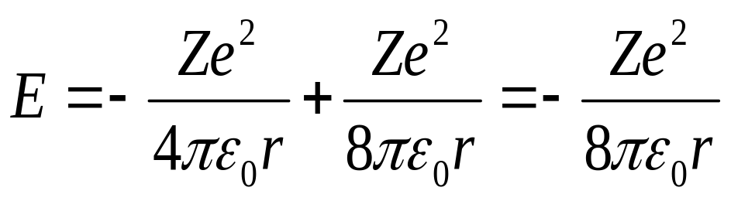
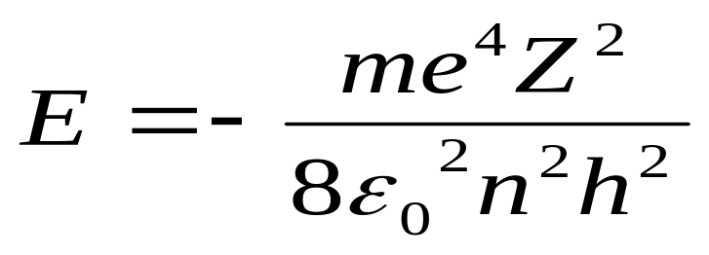
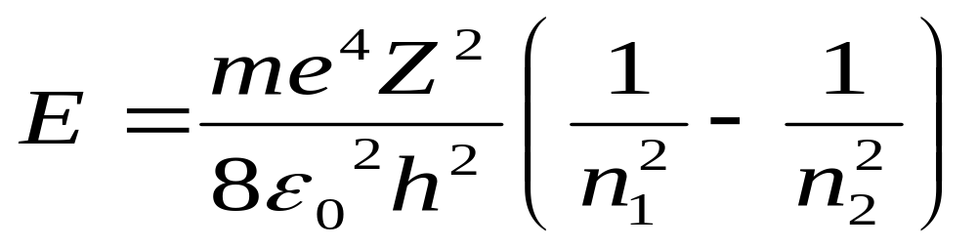
CALCULATION OF ENERGY
Total energy E = P.E + K.E
n₃
n₂
n₁
Electron
e
…….(7) Now from eqn (5) & (7)
Nucleus
r
E
When an electron jumps from energy level n₂ to energy level n₁

Slide 40
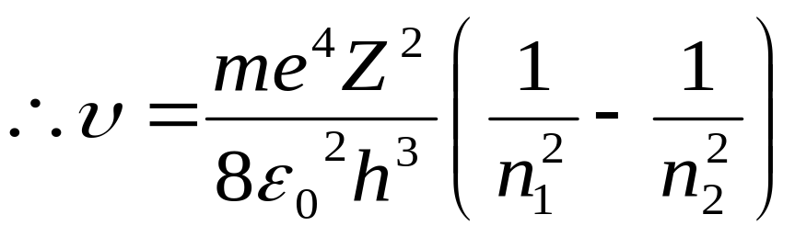
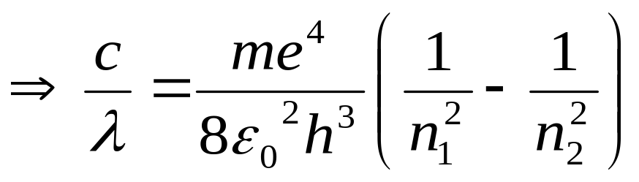
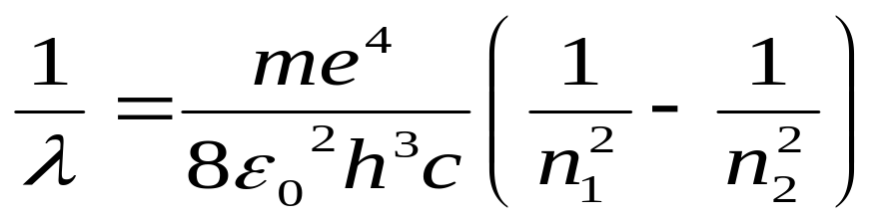
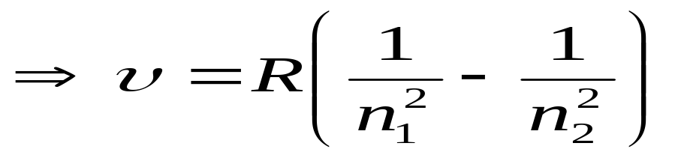
CALCULATION OF FREQUENCY
Again we know
W_{n2} – W_{n1} = E = hv
n₃
n₂
n₁
Electron
e
Since C= υλ & Z=1 for H₂
Nucleus
r
E
Where υ = 1/λ = Wave number R= Rydberg constant

Slide 41
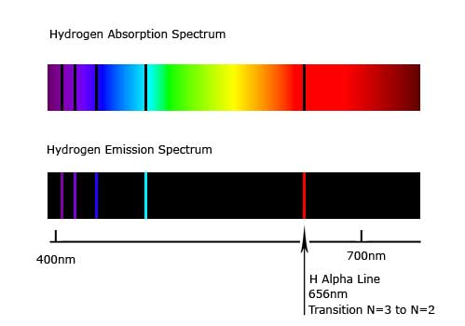
FAILURE OF BOHR MODEL
There is an adhoc nature in the assumptions of Bohr where the quantum ideas of the stationary orbits is mixed up with the classical idea of Coulomb force.
1
It can not explain the origin of the fine structure of the spectral lines.
2
3
Though it can explain the spectral lines of H₂ but it can not explain the spectral lines of multi-electron systems like Helium.

Slide 42
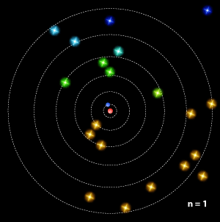
SPECTRAL SERIES OF H-ATOM
Balmer Series
Paschen Series
Bracket Series
n₁
n₂
Pfund Series
n₃
n₄
Lyman Series
n₅
n₆

Slide 43
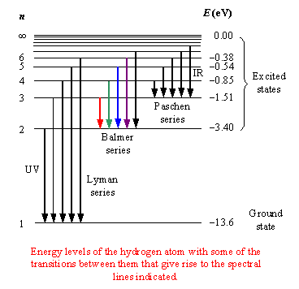
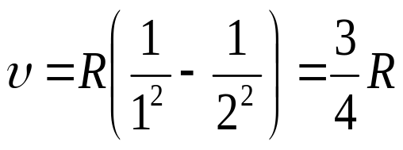
SPECTRAL SERIES OF H-ATOM
(1) Lyman Series : Outer orbits → n_{1 .} Here, n₁=1, n₂=2, 3, 4, 5……..

Slide 44
SPECTRAL SERIES OF H-ATOM
(2) Balmer Series : Outer orbits → n_{2 .} It is in the visible region of the spectrum. Here, n₁=2, n₂= 3, 4, 5…

Slide 45
SPECTRAL SERIES OF H-ATOM
(3) Paschen Series : Outer orbits → n_{3 .} Here, n₁=3, n₂= 4, 5……..

Slide 46
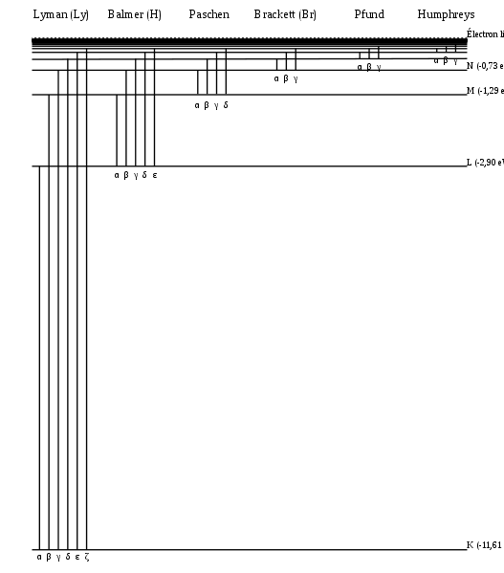
SPECTRAL SERIES OF H-ATOM
(4) Bracket Series : Outer orbits → n_{4 .} Here, n₁=4, n₂= 5, 6……..

Slide 47
THANK YOU
Notes:
What is RADAR an acronym for? Radio Detection and Ranging.
Radio wave is generated, transmitted, reflected, and detected.
RADAR unimpaired by night, fog, clouds, smoke.
Not as detailed as actual sight.
RADAR is good for isolated targets against a relatively featureless background.

